Slide 1

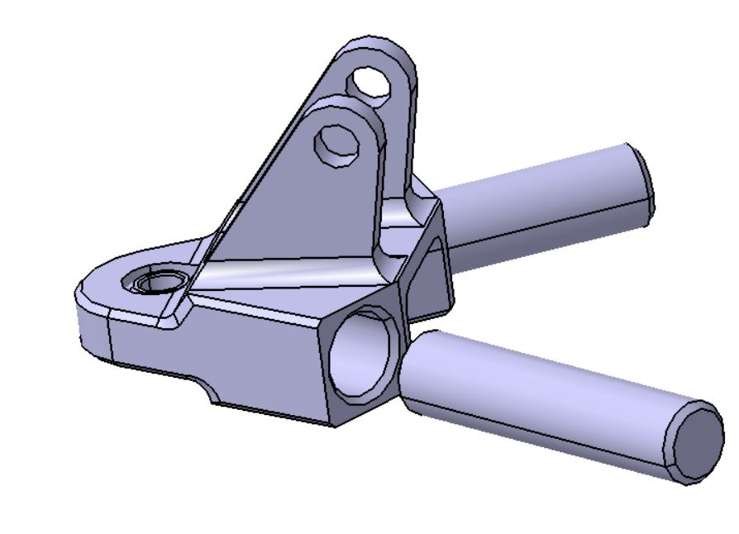

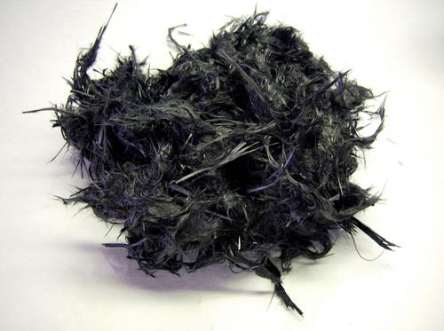
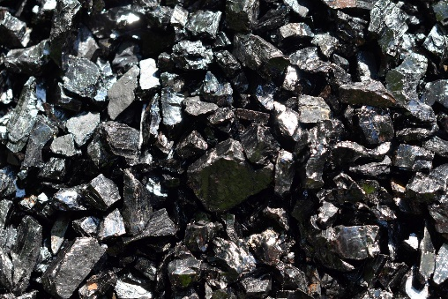
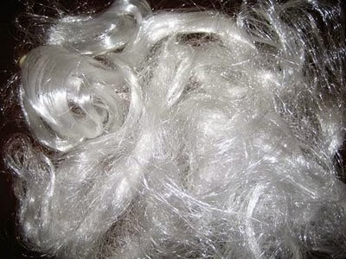
Environmental influence
Production influence
Materials recycling
The first aspect concerning the environmental influence of the car is its production. Below are some ideas to reduce environmental impact of the car production:
Limitate the shavings
By dividing one part into several (Upper bearing support, Uprights, …)
By using alternative manufacturing processes (3D printing, …)
Recycle the shavings
Reducion of oil consumption
Emulsion as lubricant (95% of water/5% water)
Dry cutting
Purchase of second-hand part for the car (engine, …)
Reduce the number of scraps
Cleaning of the machines
Increase of metrology on the parts
Promote local production
Limitation of consumables
Cleaning clothes
Abrasive stones rather than sand paper
Protective gloves reusable
Energy management
The recycling of the materials of the car is a very important aspect of the environmental influence of the vehicle production.
Some materials can be easily recycle (metallic materials for instance).
Some part bought on the market can be sold as second-hand.
Other materials are more difficult to recycle:
Composite materials
Tires
Oils
Comparing to other teams, materials such as CFRP, … which can be difficult to recycle, are not widely used on our car.
However, even these materials can be recycled. Below, 2 examples are developed: recycling of tires and recycling of CFRP.
Recycling of tires
Recycling of CFRP
Rubber powder/ aggregates
Grinding
Steel wires
Pyrolise, Grinding, …
Material recycling
Material recycling: Raw material
Material recycling
Fibers
Recycling
Crushing
Retreated tires
Material recycling
Magnetic/ Fiber separation
Crush
Material/ Thermal recycling: Raw material or fuel for Cement and Blast furnace
Thermal recycling: Combustion
Separation
Fiber
Resin
Thermal/Chemical Recyling: Decomposed oil (fuel)
Material recycling: CFRP raw material
CFRP waste
Material recycling: Raw material of CFRP

